Slide 1

Introduction to
Embedded and Robotics Programming
Cosmin Bonchis, Alin Brindusescu, Cristi Vladu
05.03.2018
Notes:
*** Version of 2017 ***

Slide 2
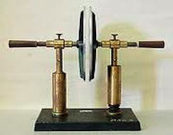
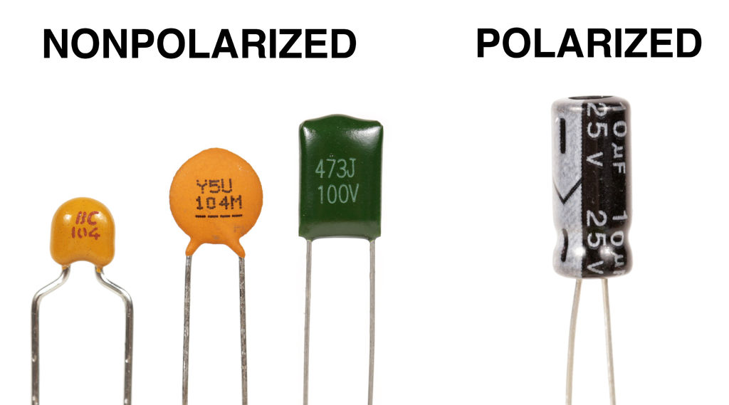
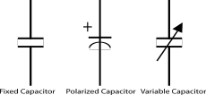
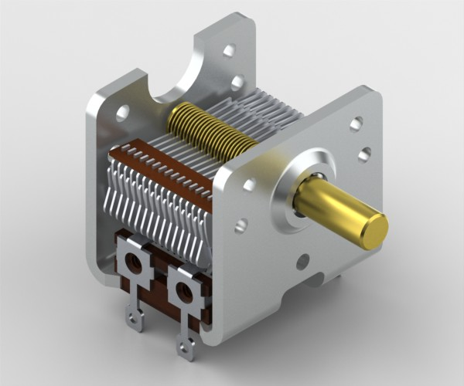
Introduction to Embedded and Robotics Programming
Basic Electronics For Programmers
Capacitors (rom: condensator)
  Passive components
  Store potential energy
  Designed to have a specific capacitance value C
  Common usage: decoupling, filtering
© University of West & Elektrobit (EB) 2018
Notes:
Dielectric, dielectric polarization
Decoupling – filtering the power for unexpected, short interruption

Slide 3

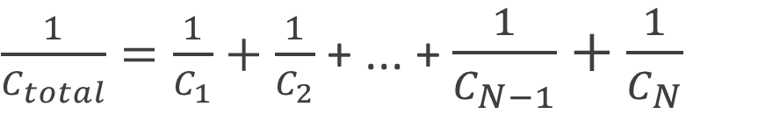
Introduction to Embedded and Robotics Programming
Basic Electronics For Programmers
Serial circuit of Capacitors
+ ... +
© University of West & Elektrobit (EB) 2018

Slide 4
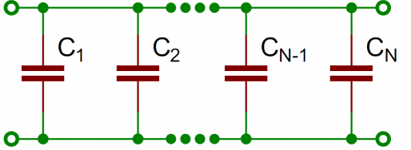
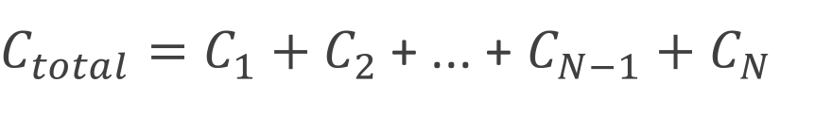
Introduction to Embedded and Robotics Programming
Basic Electronics For Programmers
Parallel circuit of Capacitors
+ ... +
© University of West & Elektrobit (EB) 2018

Slide 5
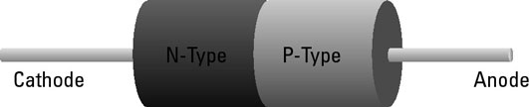
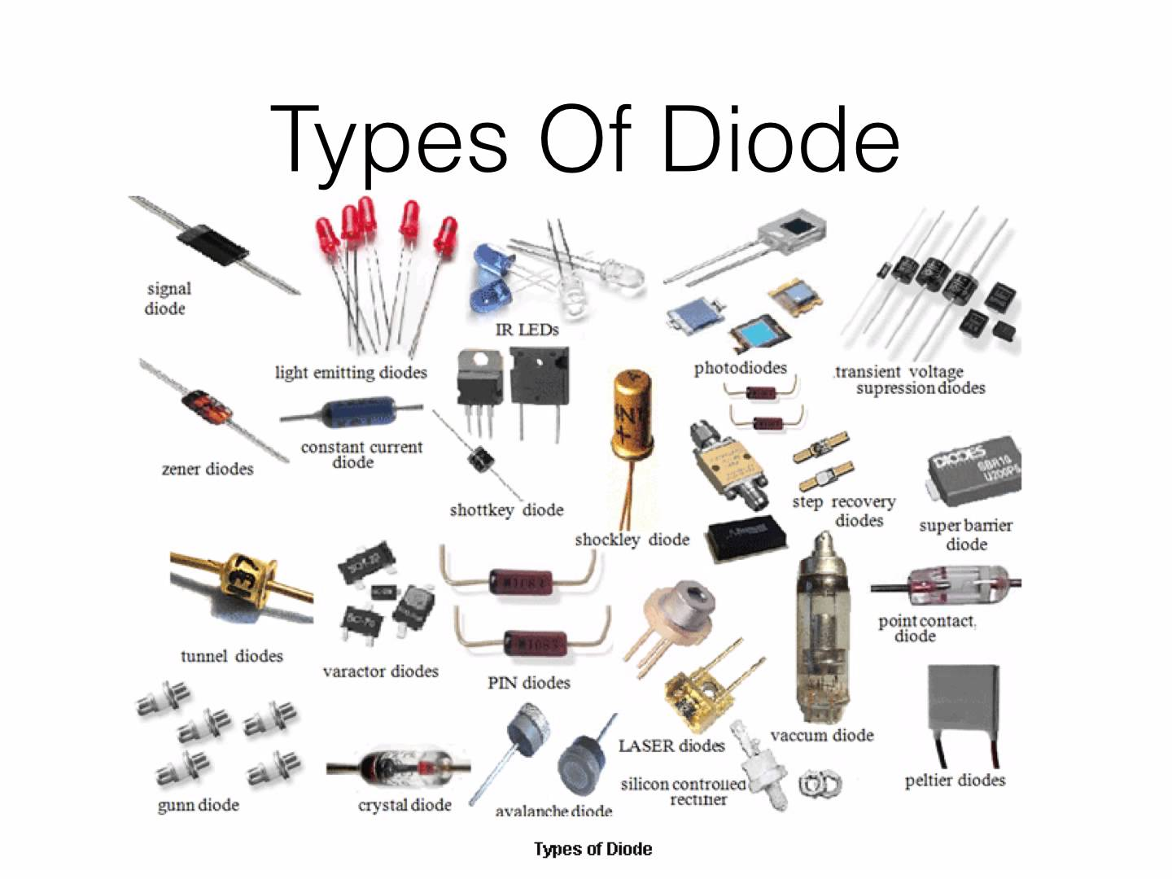
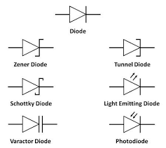
Introduction to Embedded and Robotics Programming
Basic Electronics For Programmers
Diode (rom: diodă)
  First semiconductor devices
  Zero resistance in one direction, ”infinite” resistance on the other direction
  Designed to have a specific capacitance value C
  Common usage: converting AC to DC, reverse current protection, logic gates
© University of West & Elektrobit (EB) 2018
Notes:
A combination of a P-type and N-type semiconductor material (p-n junction)
Forward Bias – current flowing from Anode to Cathode if the + is connected to the anode and the minus to cathode
Reverse bias – conecting minus to anode
Zener diode allow the current to flow in the reverse direction at the Zener voltage
Schottky diode – very fast switching
Tunnel diode – very fast switching in the range of microwave frequency

Slide 6
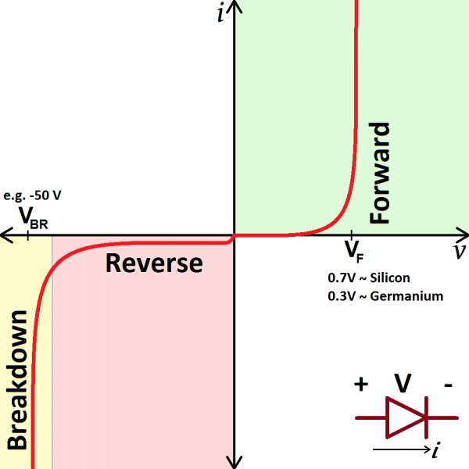
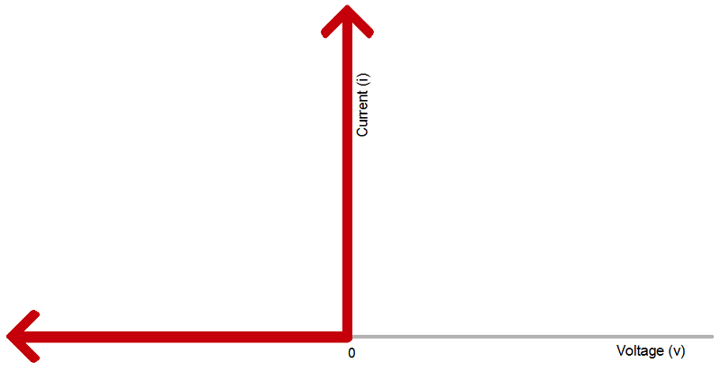
Introduction to Embedded and Robotics Programming
Basic Electronics For Programmers
Diode – theoretical vs reality
© University of West & Elektrobit (EB) 2018

Slide 7
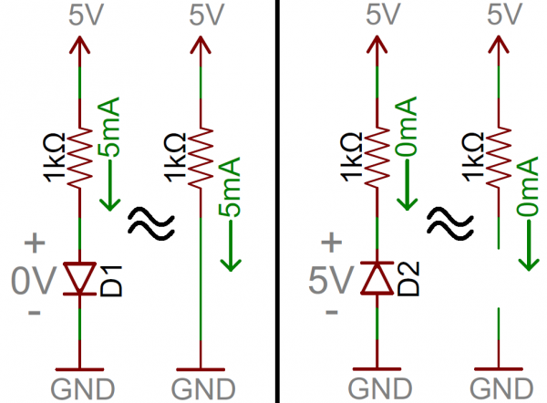
Introduction to Embedded and Robotics Programming
Basic Electronics For Programmers
Diode – simplification
© University of West & Elektrobit (EB) 2018

Slide 8
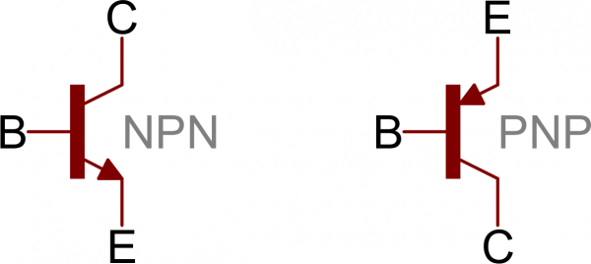
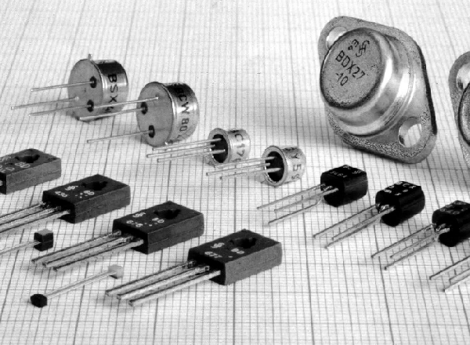
Introduction to Embedded and Robotics Programming
Basic Electronics For Programmers
Transistor (rom: tranzistor)
  Active semiconductor device
  Amplify or switch
  Types: BJT (bipolar junction transistor) and FET (field effect transistor)
  Common usage: can’t count ☺ -- buffer overflow :D
© University of West & Elektrobit (EB) 2018
Notes:
The base acts like the controllable valve, controlling the flow of electrons from the emitter to the collector

Slide 9
Introduction to Embedded and Robotics Programming
Basic Electronics For Programmers
Transistor (rom: tranzistor)
  Active semiconductor device
  Amplify or switch
  Types: BJT (bipolar junction transistor) and FET (field effect transistor)
  Common usage: can’t count ☺ -- buffer overflow :D
© University of West & Elektrobit (EB) 2018
Notes:
The base acts like the controllable valve, controlling the flow of electrons from the emitter to the collector

Slide 10
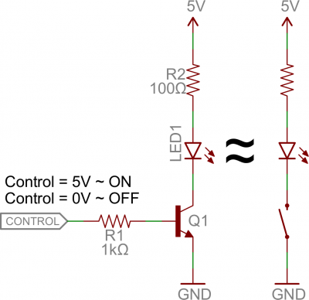
Introduction to Embedded and Robotics Programming
Basic Electronics For Programmers
Transistor – standard sample usage: switch
© University of West & Elektrobit (EB) 2018
Notes:
The base acts like the controllable valve, controlling the flow of electrons from the emitter to the collector

Slide 11
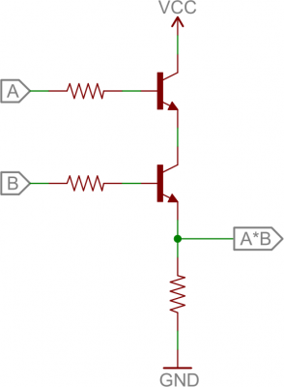
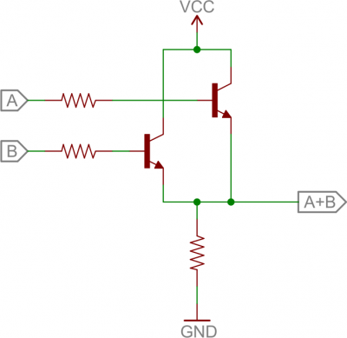
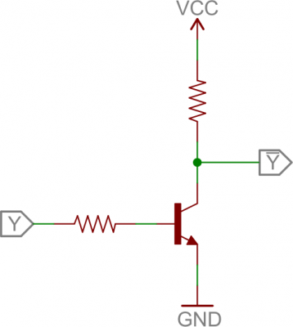
Introduction to Embedded and Robotics Programming
Basic Electronics For Programmers
Transistor – standard sample usage: digital logic
© University of West & Elektrobit (EB) 2018
Notes:
The base acts like the controllable valve, controlling the flow of electrons from the emitter to the collector

Slide 12
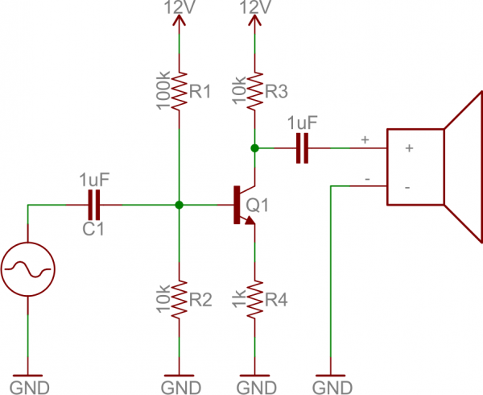
Introduction to Embedded and Robotics Programming
Basic Electronics For Programmers
Transistor – standard sample usage: amplifier
© University of West & Elektrobit (EB) 2018
Notes:
The base acts like the controllable valve, controlling the flow of electrons from the emitter to the collector

Slide 13
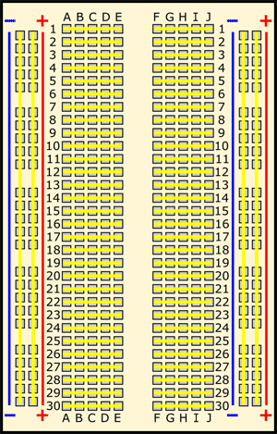
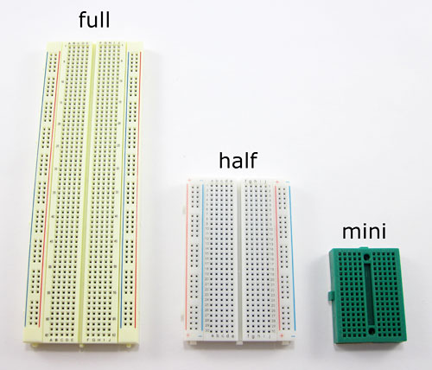
Introduction to Embedded and Robotics Programming
Basic Electronics For Programmers
Breadboard
  Used for prototyping
© University of West & Elektrobit (EB) 2018
Notes:
The base acts like the controllable valve, controlling the flow of electrons from the emitter to the collector

Slide 14
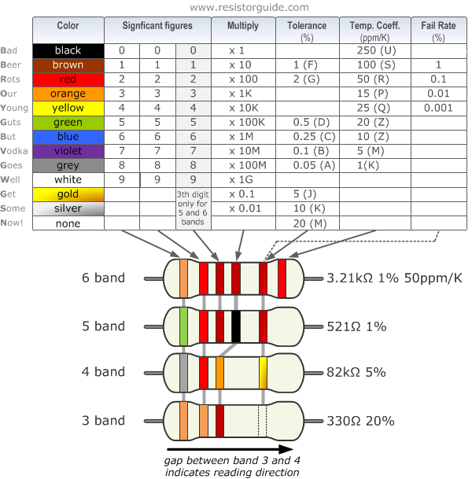
Introduction to Embedded and Robotics Programming
© University of West & Elektrobit (EB) 2018
Notes:
E1: 120 KO, 5% tolerance
E2: 130 O, 1% tolerance

Slide 15
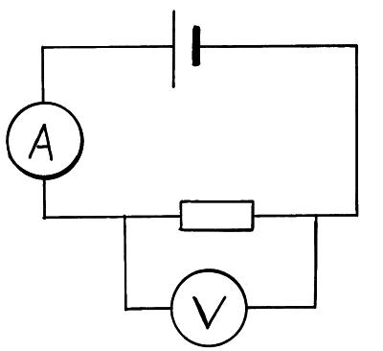
Introduction to Embedded and Robotics Programming
Basic Electronics For Programmers
© University of West & Elektrobit (EB) 2018

Slide 16
Introduction to Embedded and Robotics Programming
Basic Electronics For Programmers
More to read:
  http://www.instructables.com/lesson/Capacitors-2/
  https://www.sciencebuddies.org/science-fair-projects/references/how-to-use-a-breadboard
  https://www.kitronik.co.uk/blog/led-resistor-value-calculator/
  https://learn.sparkfun.com/tutorials/diodes
  https://learn.sparkfun.com/tutorials/transistors
© University of West & Elektrobit (EB) 2018

Slide 17
Happy Hacking!
C U next Week!
Basic Electronics For Programmers
Introduction to
Embedded and Robotics Programming
© University of West & Elektrobit (EB) 2018

